Slide 1
Internationalization: a way for competitiveness #WorldinLombardy

Slide 2
CONFINDUSTRIA LOMBARDIA

Slide 3
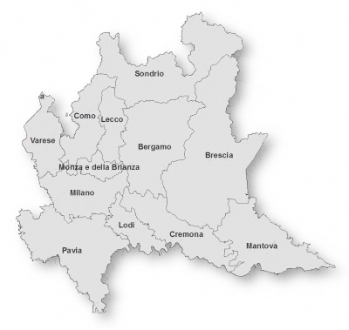











ABOUT US
Confindustria Lombardia is the Lombardy’s Entrepreneurial Federation.
Founded in 1971, it is composed by 10 local associations with 12 thousand companies and 650 thousand employees, nearly a quarter of the entire system of Confindustria

Slide 4
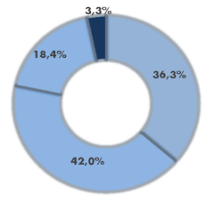
66,6% Manufacturing Activities
(especially medium tech manufacturing)
OUR COMPANIES
BIG
Over 250 em
Medium
51 – 250 em
Micro
0 – 10 em
Small
11 – 50 em
11.600 SMEs

Slide 5
INTERNATIONAL
AND REGIONAL FRAMEWORK

Slide 6
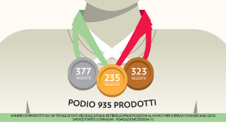
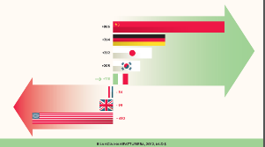
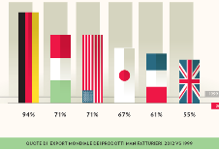
ITALY: EXPORT EXCELLENCE
Italian companies are among the most competitive in the world
Italy has kept its global market share despite the crisis, performing better than most of the developed Countries
Italy’s manufacturing surplus over 100 billion $
Source: Edison Foundation Report

Slide 7
2014 PERFORMANCE:
2,8%
212.000
5/6
The world share
of Italian export has grown
in 2014 (2,8%)
respect to 2013 (2,7%).
Number of exporters has increased
Average number of countries in which usually Italian companies
export
Source: ICE report 2014- 2015

Slide 8

GLOBAL DEMAND IS EVEN MORE ORIENTED TOWARDS MADE IN ITALY
The value of
exports
raised in 2014
Exports of goods towards
extra EU markets is increasing in 2015
Source: ICE Report 2014- 2015

Slide 9
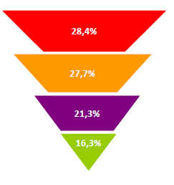
LOMBARDY IS THE BEST
PERFOMING REGION IN ITALY
Share of Lombardy on National Aggregate
32.980 € per capita income
800.000 companies
110.000 manufacturing companies
Manufacturing
Added Value
1, 5 milions employees
in manufacturing
12 Universities and 550 research centers
4 airports
707 km highway
2.000 km railway line
Export
National GDP
Open and Connected!
Population
Source: ISTAT and Lombardy Region’s S3 Report

Slide 10
EXPORT and IMPORT in Lombardy Region:
27,7 % of the value of Italian export and 30,4% of import
In 2014
Export = 109,5 Mld €
Import = 109,9 Mld €
Source: ISTAT – Coeweb Data
Source: ISTAT data

Slide 11
HIGHEST SCORES OF TOTAL ADDED VALUE IN MAIN ECONOMIC SECTORS
AND GDP
FIRST REGION IN EUROPE FOR MANUFACTURING GROSS ADDED VALUE
IF LOMBARDY WERE AN EUROPEAN COUNTRY,
IT WOULD BE THE 11° EXPORTER
Source: Eurostat 2011
Source: Edison Foundation Report Data for Strategic Plan #Lombardia2030

Slide 12
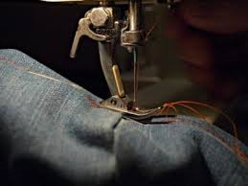
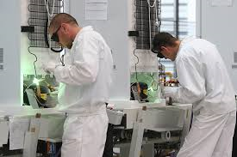
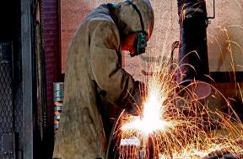
LOMBARDY IS THE BEST REGION IN SOUTH EUROPE FOR ATTRACTIVENESS
47%
+ 17%
4.721
of multinational companies with foreign capital investment, located in Italy, is in Lombardy
of foreign investment projects in 2014 respect to 2013
Number of companies with foreign capital investment which are settled in Lombardy, giving job to a total of 279.565 employees
Source: Lombardy Region- Invest in Lombardy data

Slide 13

The MEGACITIES are the main growth engines as ECO-city ambitions and principles seem to be "the new normal”;
The traditional GO TO MARKET approaches will not be suitable when addressing this new market as demand is moving towards complex value systems
Fonte: Global Cleantech report 2012

Slide 14
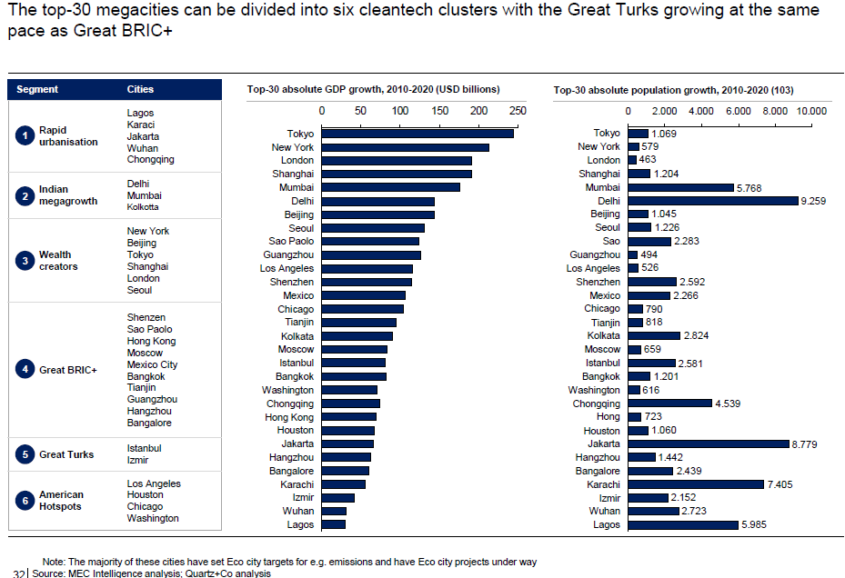
WHERE IS EUROPE ?

Slide 15
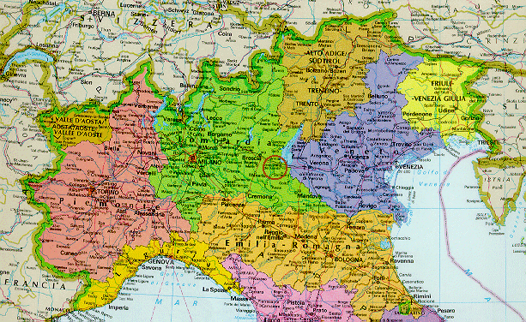
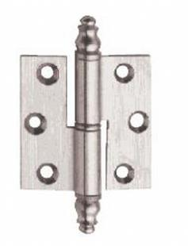
«HINGE»

Slide 16
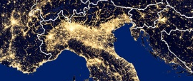
A BIG ECONOMIC HUB
Lombardy, Emilia-Romagna, Piedmont, Veneto
Share on National Aggregate
Manufacturing Added Value
64,7%
141.361 €
Export
65,2%
220, Mld €
Economy
Added Value
47,8%
698.354 €
Pop.
38,9%
23,8 Mln inhab.
Source: ISTAT data, current prices

Slide 17
WHAT CONFINDUSTRIA LOMBARDIA DOES

Slide 18
OUR MISSION
Being the hub of Lombardy industrial associative system by the enhancement and integration of existing excellences and skills.
Lobbying through Lombardy Region and Europe aiming at future’s manufacturing

Slide 19
SCALE UP
GROWTH
INNOVATION
ATTRACTIVENESS
STRATEGY
#Lombardia 2030
LOBBY
INTEGRATION
COLLABORATION
INNOVATION
CONFINDUSTRIA LOMBARDIA
MANUFACTURING 4.0
SERVICES

Slide 20

STRATEGY
#Lombardia 2030
Internationalization is a Pillar of
Confindustria Lombardia Strategic Plan

Slide 21




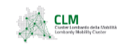



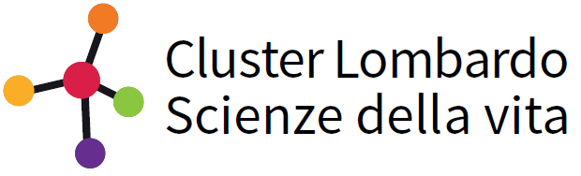
CLUSTER: THE HEART OF Lombardia #2030 STRATEGY
AEROSPACE
ENERGY&CLEANTECH
AGROOFOOD
www.aerospacelombardia.it
www.energycluster.it
www.clusteragrofoodlombardia.eu
GREEN CHEMISTRY
STRATEGIC PROJECT:
«CLUSTER»
Direct monitoring of the 9 technological regional cluster by Confindustria Lombardia’s system and its Local Associations
MOBILITY
www.chimicaverdelombardia.it
www.clusterlombardomobilita.it
TECHNOLOGIES FOR
LIVING ENVIRONMENTS
SMART CITIES
LIFE SCIENCE
www.clustertav.lombardia.it
www.clusterscclombardia.it
www.lombardialifesciences.it
www.afil.it
ADVANCED MANUFACTURING

Slide 22

NEW BUSINESS MODEL AND ITS NEEDS
Brain intensive
Bigger (cluster)
Faster
More Connected
More international
More Digital
High Skills

Slide 23
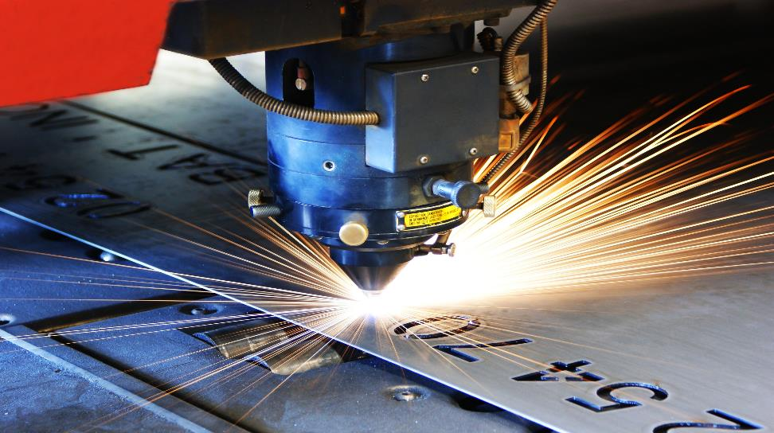
THE FUTURE
MANUFACTURING 4.0

Slide 24
CONFINDUSTRIA LOMBARDIA SURVEY ON INTERNATIONALIZATION
Sample of about 900 members
Period: 2014-2015

Slide 25
LOMBARDY: a worldwide INTERNATIONALIZATION
  More than 70% of Lombardy associated companies is involved in international trade
  Associated companies export 30% of their turnover
  More than 40% of export is towards Extra European Countries
Source: Internationalization Survey, Confindustria Lombardia, 2015 and ISTAT

Slide 26
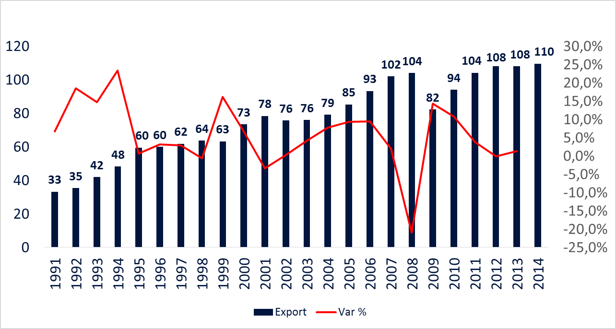
Great capacity to react to the crisis: resilience and perfomance
Lombardy’s Export 1991-2014
(Mld € and % Variation)
+ 14,3%
Mld €
Source: Confindustria Lombardia’s elaboration on ISTAT data

Slide 27
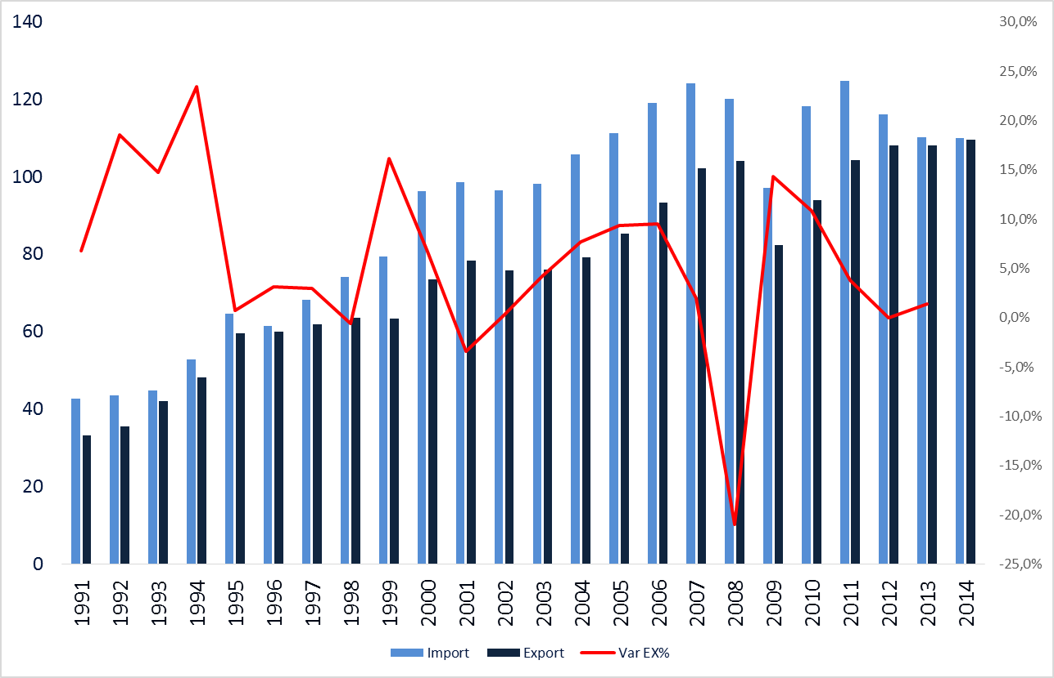
Lombardy’s International Trade
Import, Export 1991-2014
(Mld € and % Variation)
+ 14,3%
Mld €
Source: Confindustria Lombardia’s elaboration on ISTAT data

Slide 28
Our associated companies: there are more exporters than importers, but…
Source: Internationalization Survey, Confindustria Lombardia, 2015 – multiple choice

Slide 29
Internationalisation: not only export
We have to support companies in adopting a more stable strategy…
Source: Internationalization Survey, Confindustria Lombardia, 2015 – multiple choice

Slide 30
Machinery and Pharma: economic sectors with more stable international strategy
Average 29%
Source: Internationalization Survey, Confindustria Lombardia, 2015 – multiple choice

Slide 31
Associated companies ask for: B2B, partner research and
assistance on tax system and foreign law
Source: Internationalization Survey, Confindustria Lombardia, 2015 – multiple choice
Notes:
Partecipate e jv grandi
Micro e piccole export / import

Slide 32



Countries in which associated companies intend to export in the next 3 years
Posted by over 100 companies:
Germany
USA
France
China
Russia
Posted by 20-49 companies:
Messico
Austria
Japan
Iran
Algeria
Marocco
Canada
Egypt
South Korea
South Africa
Australia
Romania
Posted by 50-99 companies:
Switzerland
Brasil
UK
Arabian Emirates
India
Spain
Turkey
Poland
.1
.2
.3

Slide 33
HOW

Slide 34

KEYNOTE:
LOMBARDY IS THE RIGHT PLACE
FOR COMPANIES
TO INVEST AND TO GROW
SPECIALIZATION AND DIVERSIFICATION BOTH IN PRODUCTS AND IN THE CHOICE OF NEW
TARGET COUNTRIES
PROMOTION OF INTERNAZIONALISATION IN ORDER TO INCREASE RELATIONSHIPS WITH FOREIGN COUNTRIES

Slide 35

ACTING IN SYNERGY:
USING CONFINDUSTRIA NETWORK AS THE MAIN HUB
TO GET INFORMATION ABOUT COMPETENCES OF THE MAIN REGIONAL PRODUCTIVE SYSTEMS
TO DEVELOP
CONCRETE COLLABORATIONS

Slide 36
AN EXAMPLE

Slide 37

EXPO 2015: 6 months of intensive relations with foreign countries
A cultural exhibition which moved to a business opportunity
thanks to the efforts of organizations for collaboration
NOT ONLY FOOD SECTOR
NOT ONLY IN MILAN
NOT ONLY INSTITUTIONAL MEETINGS
MORE THAN 2 INITIATIVES PER DAY FOCUSED ON BUSINESS

Slide 38
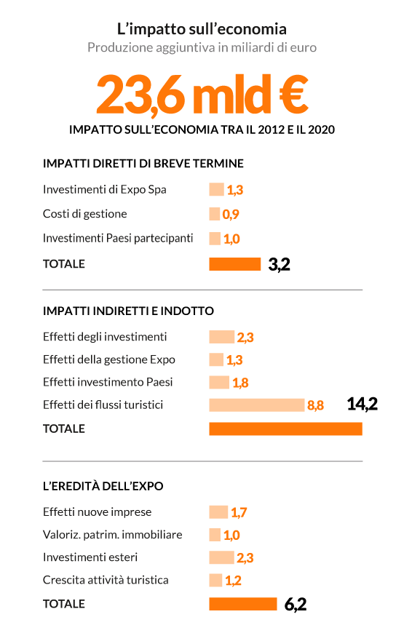
Economic impact…..
On 2012-2020:
23,6 billion of euro
(Repubblica ottobre 2015)
40.000 b2b
7.200 Italian companies participants
3.900 foreign companies participants
(Camera di Commercio di Milano)
On 6 months:
2,7 billion of euro
+0,4 on GDP
(Sole 24 Ore)

Slide 39
!
If we see what we have done…GREAT RESULTS
400 Foreign Delegations
520
events organized by entire system
EXPO gave us the
chance to get known and
to show globally
our manufacturing
excellence and skills
Most of the companies ask us to help them to follow up meetings
We are working on trasforming Expo site into an International HUB for innovation, talents, knowledge and manufacturing 4.0

Slide 40

THANK YOU!

